Slide 1


Slide 2

CMP2804 Team Software Engineering
Week 8

Slide 3
Scheduling and organising
Work Breakdown Structure (WBS)
Gantt Charts
PERT Charts
Critical Path

Slide 4
Scheduling
“The process of planning the project timeline, tasks, resource allocation and dependencies…”
GOAL?
To provide a roadmap for your team to ensure the project stays on time and within the resource allocation.

Slide 5
Scheduling – some terminology
Timeline: Start/end dates, milestones, deadlines.
Tasks: All activities which must be done to complete the project.
Deliverables: Products, process, events, results, etc.
Resources: People, equipment, time, budget (if relevant).
Dependencies: Relationships between tasks – i.e. which tasks must be completed before others can start.
Milestones: Major points in the timeline marking a deliverable or deadline.
Critical Path: The order of tasks which result in the shortest time to project completion.
Work Breakdown Structure: A hierarchical list of tasks making up the project.

Slide 6
Work Breakdown Structure
Defines the scope of the project.
Lists all tasks and deliverables for the project.
Arranged in a hierarchy.
0. Web App
Top level/
Overall Scope
Major
deliverables
1. Project Management Docs
2. Requirements
3. Back End
4. Front End
5. Testing
1.1 Project Scope
2.1 Visual Design Theme
3.1 Database Dev
4.1 Landing Page
5.1 Beta Testing
Sub-Tasks
1.2 WBS
2.2 User Stories
4.2 Admin Interface
5.2 Regression Testing
1.3 Project Management Plan
5.3 Release Candidate

Slide 7
0. Web App Project
1. Project Management Docs
1.1 Project Scope
1.2 Work Breakdown Structure
1.3 Project Management Plan
2. Requirements
2.1 Visual Design Theme
2.2 User Stories
3. Back End
3.1 Database Dev
4. Front End
4.1 Landing Page
4.2 Admin Interface
5. Testing
5.1 Beta testing
5.2 Regression Testing
5.3 Release Candidate
A hierarchical list of tasks
In an agile project setting, this may be amended as the project progresses….

Slide 8
Dependencies?
Task 1
Task 2
End to start
Task 1
End to end
Task 2
Task 1
Start to start
Task 2

Slide 9
WBS Dictionary
WBS Code | WBS Name | Description | Dependencies | Duration (Days) | Resources (People)
1 | Project Management Doc. DELIVERABLE | All documentation for planning the project |  | 9 | 4
1.1 | Project Scope | Project Scope Document |  | 4 | 4
1.2 | WBS | Create a WBS |  | 3 | 4
1.3 | Project Management Plan | Planning document for the project |  | 5 | 4
2 | Requirements DELIVERABLE | Requirements for the project | 1.3 | 6 | 4
2.1 | Visual Design Theme | The look and feel for the pages | 1.3 | 5 | 2
2.2 | User Stories | The user requirements and use cases | 1.3 | 6 | 2
3 | Back End DELIVERABLE | The back office functionality | 2.2 | 6 | 1
.. | .. | .. | .. | .. | ..

Slide 10
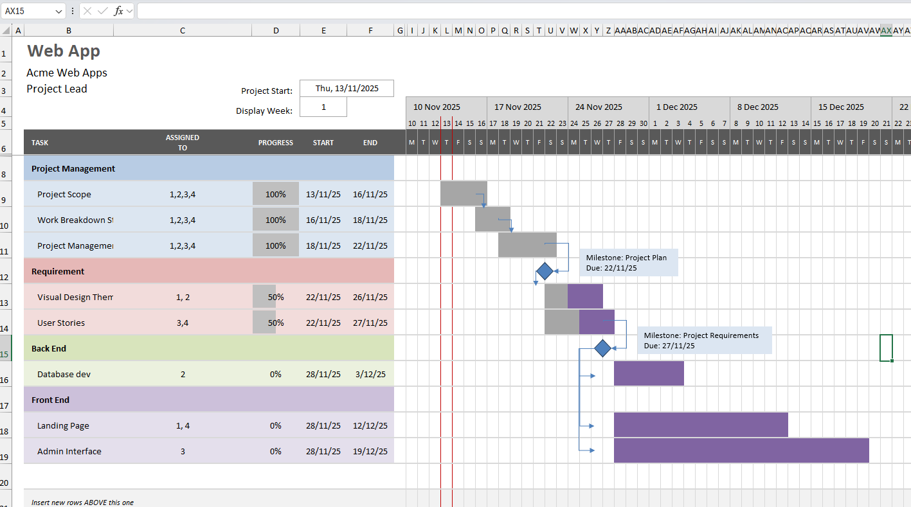
Gantt Chart
The WBS identifies all deliverables and tasks in the project.
The Gantt chart refactors this into a time-based plan.

Slide 11
Gantt Chart
Typically include: tasks, task start date, task end date, task owner, milestones, etc
Positives
Provides a quick snapshot visualisation of the project
Enables task dependencies to be monitored
Makes keeping track of the resource management and task allocation easier
Negatives
Hard to estimate task durations
Hard to manage changing tasks/staff/etc
Gets messy/chaotic quickly as more tasks/milestones /etc are added

Slide 12
PERT CHART (Program evaluation and review technique)
A network diagram of the project. Helps to visualise task dependencies and the Critical Path.
Project Scope Doc
13/11 – 16/11 (4)
Visual Design Theme
22/11 – 26/11 (5)
Exercise:
What is the sequence of tasks which result in the longest path through the project?
This is the shortest time the project can complete…
5 mins…
Web App Project
WBS
16/11 – 18/11 (3)
User Stories
22/11 – 27/11 (6)
Database Dev
28/11 – 03/12 (7)
Proj. Man. Docs
18/11 – 22/11 (5)
Landing Page
28/11 – 12/12 (16)
Admin Interface
28/11 – 19/12 (23)

Slide 13
Task Time estimation
Optimistic Time: Shortest time a task can be completed.
Most Likely Time: Task completion time having the highest probability.
Pessimistic Time: The longest time a task might require.
The Estimated Time = (Optimistic Time +(4 x Most Likely Time) + Pessimistic Time)/6
So, for a task with:
Optimistic: 3 days
Most likely: 6 days
Pessimistic: 10 days
Estimated = (3 + (4 x 6) + 10)/6 = 6.2 days (7 full days)

Slide 14
PERT CHART (Program evaluation and review technique)
Positives:
Great for identifying critical path through project
Can visualise dependencies and workflow
Easy to perform ‘what-if’ type scenarios
Negatives:
Takes a lot of time to set up
Not ideal if multiple projects are in action and need to share resources
Places a lot of emphasis on time – doesn’t focus on costs for example.

Slide 15
Exercise:
Amy is responsible for tasks G and H.
Once she finishes G, she needs to take 1 day off.
Will this cause any delay to the project?
5 mins …
G, 4
H, 3
A, 3
I, 2
C, 2
E, 4
B, 2
D, 3
F, 1

Slide 16
What does this mean for Your team?
Gantt and PERT are complimentary – they are both useful!
Gantt is good for scheduling
PERT is good for dependencies and identifying possible delays
A Work Breakdown Structure
When planning your project, these tools will help to visualise the project.

Slide 17
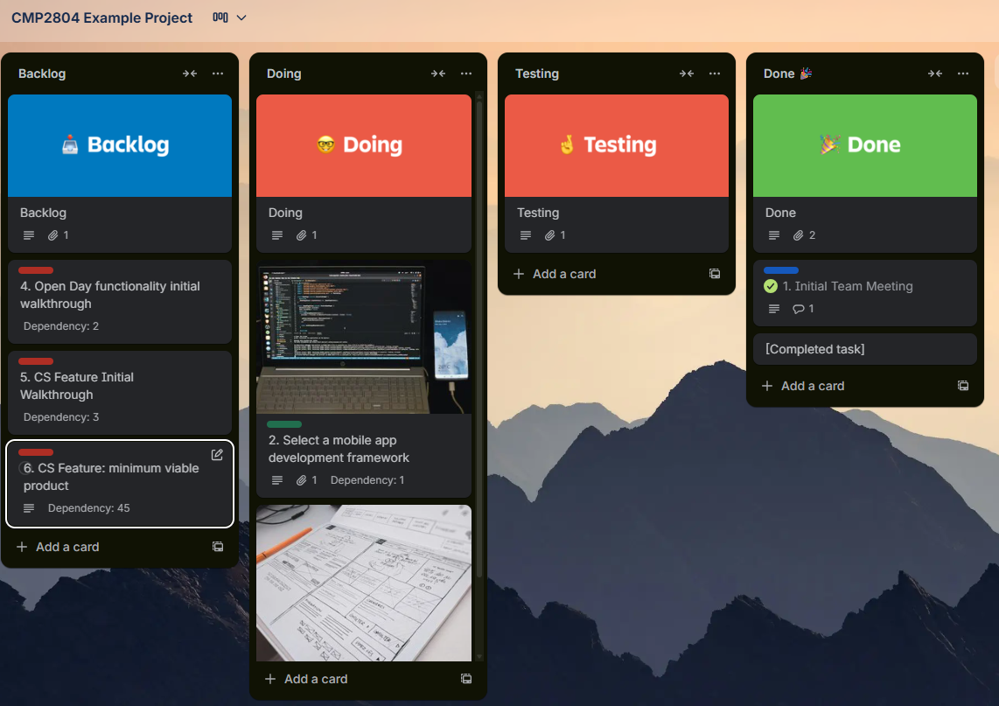
Are Kanban boards and Gantt/PERT charts compatible…?
YES!
Gantt/PERT are good for planning, scheduling etc
Kanban is good for process/task management

Slide 18
Resources
Gantt Charts
Association for Project Management
https://www.apm.org.uk/resources/find-a-resource/gantt-chart/
Atlassian
https://www.atlassian.com/agile/project-management/gantt-chart
PERT charts
Project Management Academy
https://projectmanagementacademy.net/resources/blog/a-three-point-estimating-technique-pert/
Atlassian
https://www.atlassian.com/work-management/project-management/pert-chart
Critical Path
Atlassian
https://www.atlassian.com/work-management/project-management/critical-path-method

Slide 19

Thank you!
Summary
Work Breakdown Structure (WBS)
Gantt Charts
PERT Charts
Critical Path

